Slide 1
Public Procurement Albania
AIS's commitment towards Transparency, as well as Improving Accountability and Dialogue within the Cluster 1 negotitation framework
Aranita BRAHAJ - Project Lider AIS
Viktor GUMI - AIS's Legal Expert

Slide 2
AIS is a local organization founded in 2011, best known as the promoter of Open Data Albania, working on Transparency, Accountability and Good Governance
SIDA Support and Partnership. For the March 2021 – February 2024 period AIS is implementing the "Open Data Access and Transparency over Sectors exposed to Risk of Corruption" project. Supported by the Swedish International and Development Cooperation Agency, SIDA
Focus: Open Data, Evidence Based Approach and Anti-Corruption
AIS has contributed in fostering dialogue for better public policies through Research Articles; Publications, Litigation and drafting of Policy and Position Papers
AIS is working with young people through its OpenDataFellowship Youth Network on educating, capacity building, as well as internshiping the fellows on articulation and public debate based in facts and data
AIS is part of a Consortium of 4 Local NGO-s, aiming to Improve Policy Debate and Accountability in the Fulfillment of the First Group of Negotiating Chapters Cluster One, C1-EU-NPA
AIS and IDM are local partners with Transparency International TI, in the implementation of the Project “EU4Rule of Law: Citizens Engagement for Public Integrity (CEPI) in the Western Balkans and Turkey”

Slide 3
AIS owns databases, which have thave enabled the empowerment of public actors, through easy access to information and facilitation on the monitoring of the public sector (expenditures, procurements, contracting, asset declaration)
Follow the Money https://ndiqparate.al/ through transparent data and socio-economic research articles
Open Procurement Albania https://openprocurement.al/ Open and transparent data regarding each stage of tendering process in sectors or institutions like Health; Road Infrastructure; State Owned Enterprises; Municipality; Albanian Fund for Development. The database also contains an instrument for risk assessment as an algorithm marks with a RedFlag tenders with potential risk for abusse and clientelism
Spending Data Albania https://spending.data.al/ platform constitutes a database containing all the information regarding payments issued by the State Treasury from 2012 ongoing. These payments are listed and can be traced by Institution; beneficiary client; date of execution; category of expenditure, or description of invoice
Asset Declaration http://moneypower.al/ is a database containing data present in the mandatory Asset Declaration Form, compiled by senior officials, MPs, mayors, members of the Council of Ministers, and Magistrates
Open Corporates Albania https://opencorporates.al/ another platform offering open data profiling and passports with information for every business that wins public contracts (with state institutions)
Access Justice http://www.aksesrejtesi.al/ Information and Passport with accessible data and documents concerning High Level Judges

Slide 5
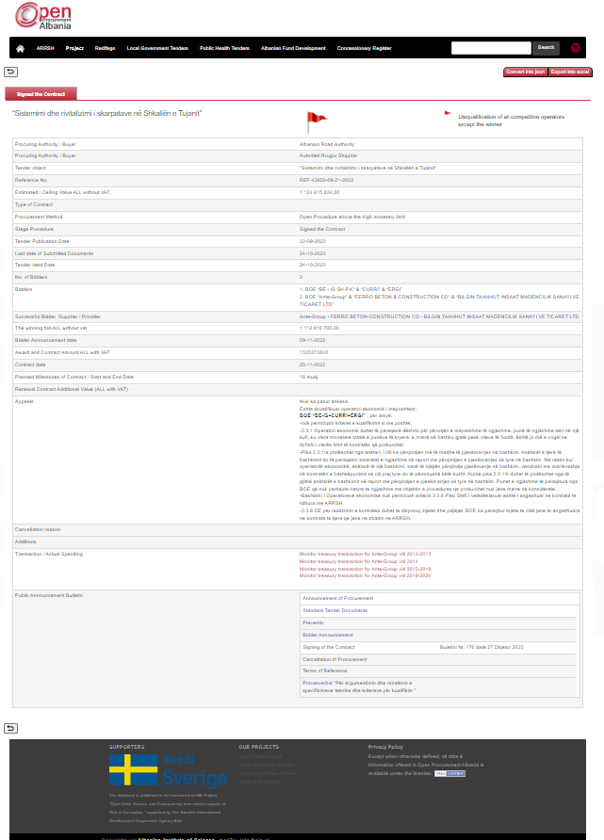

Slide 6
Open Procurement Albania is a database containing well-structured data, easily accessible, as well as analytical information for all public tenders carried out by the Municipalities; Albanian Development Fund; Albanian Road Authority; Health Sector; Centralized Purchasing Agency and State Owned Enterprise
For each tender we create a Passport containing information on the tendering procedure, by the first notification till at the Budget payment. The passport lists all the Tender Documents (the institutions stop publishing/advertising the relevant tender documents after the finalisation of the tendering)
The information, distributed by institutions is closed formats pdf, not consistent in time and not integrated or comprehensible to third parties
The AIS team collects and gather all documents, data and information regarding a Tender and creates the integrated tender PASSPORT according to the Open Contracting Standard
In the end, an algorithm for risk assessment makes possible to mark with RedFlag tenders displaying risk of potential irregularities. The algorithm assesses only the variables of Competition and Competitiveness
Models: Instruments and Principles of Open Contracting Partnership; Risk Assessment Tools from Transaprency International

Slide 7
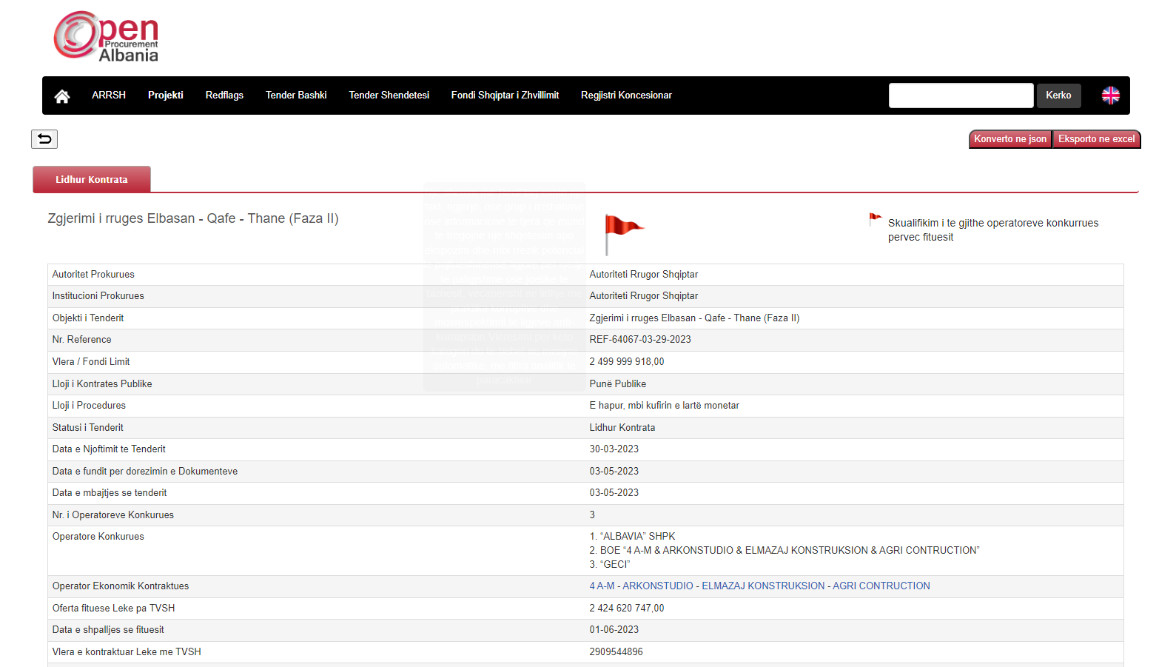

Slide 8
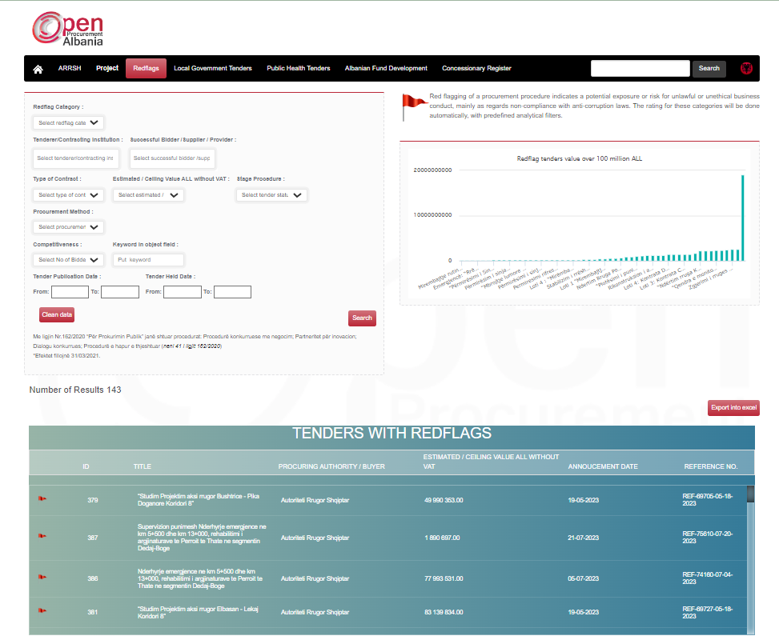
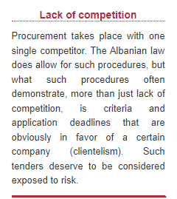
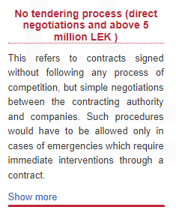
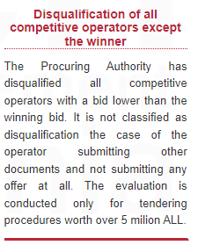
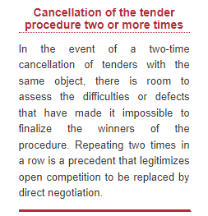

Slide 9
What we have found
Disclosed Data and RedFlag Assessment prompt media investigations; public debates; audits of the Suprem State Control, in some cases even Criminal Complaints in SPAK are based on Open Procurement Albania evidence
15 to 35% of Tender procedures are RedFlaged, marked for displaying concerning competition and potential clientelism. Municipality tenders score 15% Redfleg procedures, while the Health Sector 30%
Concentration of Tenders in the hands of few Competitors. Absence of foreign companies: 42% of the value tendered in the frame of the State Reconstruction Program was awarded to only 30 local business companies
Businesses Companies allegedly involved in money laundering of organized crime, were given the status of Public Contractor in tenders. (SPAK has started several investigations, complaints have been filed by MPs and the Opposition and evidence can be accessed via the OpenProcurementAlbania Database)
Special Laws for certain programs and natural disaster situations have created room for Clientelism
In 2021, around 28% of the tendered value was tendered through the Restricted Procedure, as established through the Special Law

Slide 10
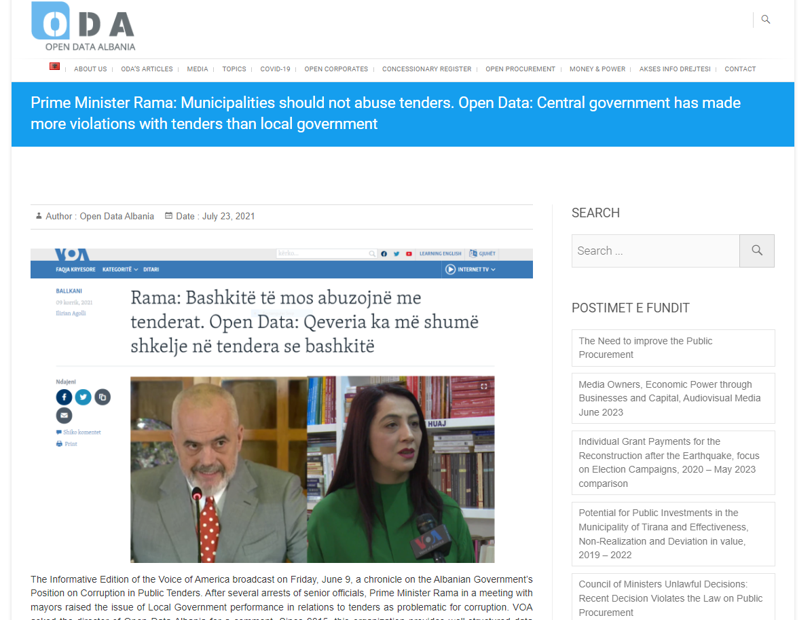

Slide 11
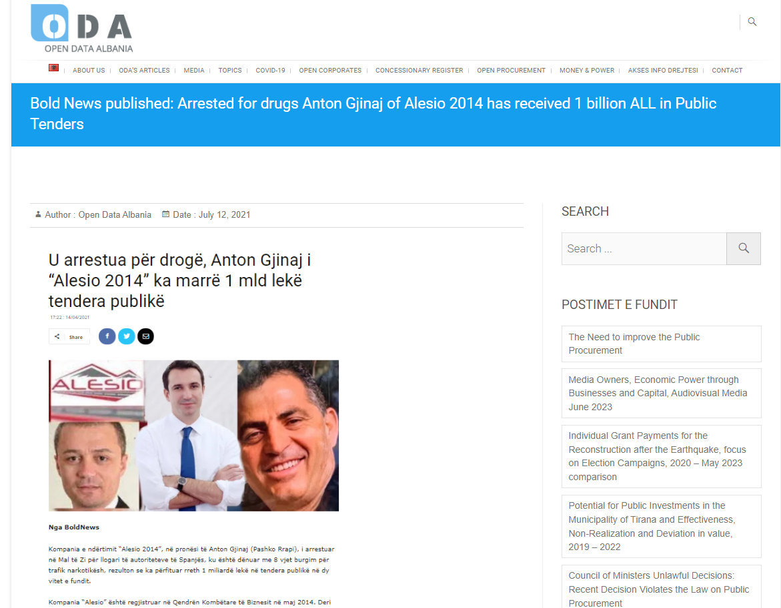

Slide 13
Debate and Accountability on Fulfillment of the First Group of Negotiating Chapters Criteria, chapter on Public Procurement
AIS Policy Paper, February 2022
Public Procurement Albania through the lens of European Integration. Author V. Gumi https://ais.al/new/wp-content/uploads/Public-Procurement-Policy-Paper-AIS.pdf
Recommendations
We need to avoid frequent changes in procurement legislation. This is a lesson learned from past experience. Although there are many skeptics about this (justice reform with frequent changes of laws is a clear indicator), frequent changes need to be eliminated and transparency and inclusiveness must be ensured throughout the legislative process
There is a specific phenomenon in Albania in the field of procurement. Thus, the more the legal basis of public procurement is improved, the greater the number of special procedures that circumvent these procurement provisions, both by special laws and by decisions of the Council of Ministers. The law "On public procurement" has been assessed by local and international actors, and the bodies of the European Union; it is a good law that respects the best standards in the field
Ilustration: Complaint filed in the Constitutional Court, calling for the repeal Special Law 97/2019, proposed by the Albanian Governement and approved by the Parliament, with serious financial repercussions. Through its legal action, AIS presented arguments regarding the negative effects the application of said Law would have

Slide 14
Debate and Accountability on the Fulfillment of First Group of Negotiating Chapters Public Procurement Chapter Criteria
Policy Paper, February 2023
Integrity Control of Public Contractors. EU Practice and Contracting in the Albanian Context – The document was drafted by AIS, in collaboration with renown expert Eduard Halimi. https://ais.al/new/wp-content/uploads/Integrity-control-of-public-contractors-EU-practices-vs-contracting-in-the-Albanian-context.pdf
Conclusions
The control of the integrity of companies that receive public funds/assets is a very important process, which constitutes the main pillar of the essential principles of public procurement, wich aim to protecting the public goods, free competition and the fight against corruption. Integrity control is a key element and inextricably linked to accountability and responsibility
On the other hand, the legislation is not complete, especially because there is no legal means to stop companies that are registered in tax havens in black/grey list countries from participating in public procurements, i.e stop them from competing
Despite the fact that the law on the declaration of beneficial owners made some steps forward in this context, this initiative is not sufficient to guarantee open, fair and competitive public procurements, as well as immune to corruption

Slide 15
Debate and Accountability on the Fulfillment of First Group of Negotiating Chapters Public Procurement Chapter Criteria
Policy Paper, February 2023
Integrity Control of Public Contractors. EU Practice and Contracting in the Albanian Context – The document was drafted by AIS, in collaboration with renown expert Eduard Halimi. https://ais.al/new/wp-content/uploads/Integrity-control-of-public-contractors-EU-practices-vs-contracting-in-the-Albanian-context.pdf
Recommendations
Recommendation 1: In accordance with EU practice, the establishment of legal penalties regarding the public contracts which have been found in violation of the principle of integrity, after the veracity of claimes has been proved following the conclusion of the contract (punishment of economic operators when they have circumvented the self declaration regarding criminal records, or they have played the system, by colluding with companies with the aim of distorting competition).
Recommendation 2: Prohibiting/restricting economic operators that are registered in fiscal havens from competing in public procurements, until a better control of money laundering is ensured and Albania leaves the watch list, the list of countries at risk for money laundering.
Recommendation 3: The same integrity control principles should be extended not only to the company winning the public contract, but also to subcontractors which undertook to work for those same public contracts. Recommendations of specific nature:
After Albania has been expulsed from this list (grey list for the prevention of money laundering) then we could offer more specific recommendations for the intervention of the legislator through amendments, such as in law no. 112/2020 "On the register of beneficial owners”

Slide 16
The Need for Improvement in Public Procurement Legislation
Comments/Recommendations in the framework of the Public Consultation Process regarding the Draft Law presenting Amendments to Law 162/2020
The organization AIS, promoter of Open Data Albania, engaged in monitoring and identifying issues related to the Public Procurement, comments and recommendations regarding the draft law "On several additions and amendments to law no. 162, dated 23.12.2020 on Public Procurement”, that is currently in the Public Consultation Process and was presented by the Albanian Government in June-July 2023
The comments and opinions we are presenting are related solely to three new concepts of the Draft Law
a) The procurement process is taken out of the public domain, i.e., involving private-non public entities that will play the role of Contracting Authorities in the public procurement process;
b) A new EPS (Electronic Procurement System) is introduced. Such system presented in the draft includes two innovations: firstly, it is harmonized with, and integrated into other electronic systems, and secondly, this new EPS is accessible to users against payment. The country has been already applying for years an Electronic Procurement System that provides good and cost-free access for users who participate in tenders and user who monitor the processes;
c) Introduction of Artificial Intelligence as a mechanism that will serve to develop the PES for standardizing technical specifications, as well as to develop a dynamic electronic procurement and auction system using advanced Artificial Intelligence and automated processes, etc.

Slide 17
The Need for Improvement in Public Procurement Legislation
Conclusions and Recommendations
AIS, calls on the Council of Ministers to withdraw the draft from the Consultation and Advancement phases, as we deem it premature and deficient in its compatibility with national legislation. Additionally, it requests that (the Council of Ministers):
1. Initiate a technical evaluation of the current state of the existing Electronic Public Procurement System, which will serve as a basis for future legislative initiatives. Consider the possibility of integrating the current system, instead of creating an entirely new and expensive EPS, resort forms of public-private partnerships or transferring public services to the private sector
2. In any future initiative, carefully consider how to guarantee the principle of transparency and participation in the Public Procurement Process, while assessing the risk of limiting such transparency and participation by introducing payments for services
3. Clearly and responsibly present any transfer of duties, functions, and competencies from the Public Sector or Authority to the Private Sector
4. Ensure that legislative initiatives refer specifically and carefully to all provisions or reference to EU Directives applicable
The proces in Ongoing

Slide 18
The position of the AIS Organization for the Creation of the Joint Stock Company Operator of Centralized Purchases. 13 September 2023 https://ndiqparate.al/?p=19977&lang=en
The Council of Ministers has approved Decision No. 531 / 2023 with the purpose of “Creating the State Joint Stock Company “Centered Purchases Operator JSC”, in order to perform Special Public Procurement Procedures”
According to this decision, the Centered Purchases Operator is a joint-stock company, with State Capital, that operates on the basis of the Law on Merchant and Commercial Companies
This decision of the Council of Ministers, published in the official gazette No. 133, dated 12/09/2023, is in violation of the Law on Public Procurement. https://qbz.gov.al/eli/fz/2023/133/38039e09-5039-4497-a93d-ada1062326eb
More specifically, the Article 4, point 1, letter b of Law 162/2020 on Public Procurement provides that "The Contracting Authority is any entity established to pursue a general interest of a non-economic or commercial nature." As a result, the Centered Purchasing Agency cannot function as a joint-stock company (commercial, economic character)
This DCM contradicts the Law on Public Procurement and must be immediately declared invalid by the Council of Ministers itself
We call upon the Public Procurement Agency not to make any registration in the Electronic Procurement System for this Procuring Authority Entity created via a DCM, but in clear contradiction to the law. If the Council of Ministers will not withdraw the DCM, the AIS/ Open Data Albania Organization will take legal steps demanding the Invalidity of the Act, through a Lawfulness Test Indictment

Slide 19
Follow us:
www.ais.al
@AlbanianInstituteOfScience
@AIScience
@aiscience

